Slide 1
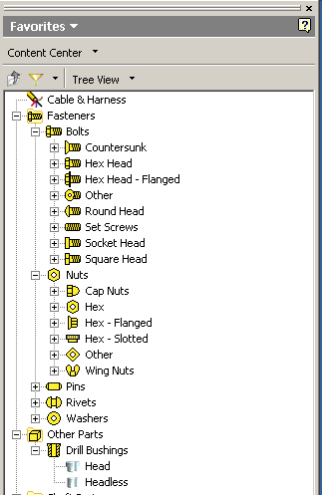
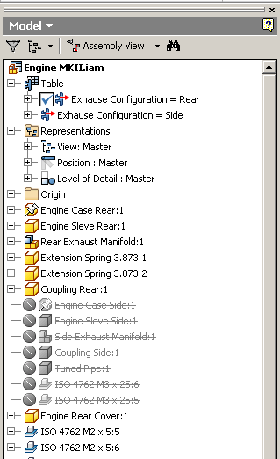
Browser
Presenter
Developer Technical Services

Slide 2
Agenda
Browser Pane & Browser Node
Client Resource
Browser Events
Browser Folder

Slide 3
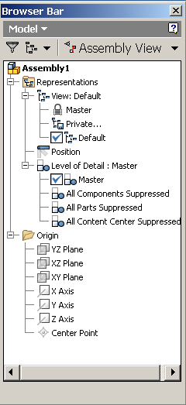
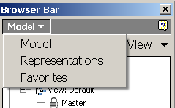
Browser Pane
Hierarchical representation of
the contents of the current document
Only one pane is visible at a time,
but the user can switch between panes

Slide 4
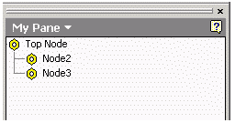
Browser Node
Hierarchy
root node
node
child node
Created by
Inventor: native Panes/Nodes
3rd party: client Panes/Nodes

Slide 5
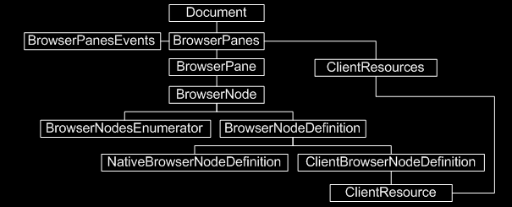
Object Model Diagram

Slide 6
Objects
BrowserPane
Native
Client
-> BrowserPane.BuiltIn
BrowserNode
BrowserNodeDefinition: Definition of node
Native
- NativeBrowserNodeDefinition
Client
- ClientBrowserNodeDefinition
- BrowserNodeDefinition.BuiltIn

Slide 7
Client Resource
ClientNodeResource
Stores the images
Define the icon for a new ClientBrowserNodeDefinition
Override the icon of an existing BrowserNodeDefinition (either built-in or client-created).
Document context
ClientNodeResources. Add( ByVal ClientId As String,
ByVal Id As Long,
ByVal Icon As Picture )
Icon: Input IPictureDisp of a 16X16 pixel image. Only bitmaps are
supported as a valid input type.

Slide 8
Add Client Resource Example
VB/VBA
VB.NET
Dim oRscs As ClientNodeResources
Set oRscs = oPanes.ClientNodeResources
Dim oIcon As IPictureDisp
Set oIcon = LoadPicture("c:\temp\test.bmp")
Dim oRsc As ClientNodeResource
Set oRsc = oRscs.Add("Test", 1, oIcon)
Dim oRscs As ClientNodeResources
oRscs = oPanes.ClientNodeResources
Dim clientNodeIcon As stdole.IPictureDisp
clientNodeIcon = Microsoft.VisualBasic.Compatibility.VB6.ImageToIPicture(New
System.Drawing.Bitmap(My.Resources.test))
Dim oRsc As ClientNodeResource
oRsc = oRscs.Add(m_ClientId, 1, clientNodeIcon)
Notes:
Microsoft.VisualBasic.Compatibility.VB6.IconToIPicture is obsolete. Refer to Browser.VB.NET-VS2010-Free-Registry. It uses AxHost to convert.
Dim clientNodeIcon As stdole.IPictureDisp = AxHostConverter.ImageToPictureDisp(My.Resources.test)
Friend Class AxHostConverter
Inherits AxHost
Private Sub New()
MyBase.New("")
End Sub
Public Shared Function ImageToPictureDisp(image As Image) As stdole.IPictureDisp
Return DirectCast(GetIPictureDispFromPicture(image), stdole.IPictureDisp)
End Function
Public Shared Function PictureDispToImage(pictureDisp As stdole.IPictureDisp) As Image
Return GetPictureFromIPicture(pictureDisp)
End Function
End Class

Slide 9
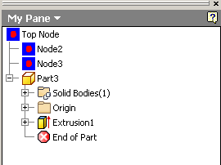
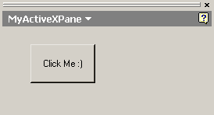
Browser Pane Type
Tree View
Native browser tree nodes can be instanced to generate
a completely customizable tree view
BrowserPanes.AddTreeBrowserPane
ActiveX
Explicitly used to host ActiveX controls
BrowserPanes.Add
Notes:
Public Function AddTreeBrowserPane( _ ByVal Name As String, _ ByVal InternalName As String, _ ByVal TopNodeDefinition As BrowserNodeDefinition _ ) As BrowserPane
Parameters
Name Input string that specifies the name of the browser pane. This is the name that will be displayed to the user. The name must be unique with respect to the other browser panes currently created for the document. It can be changed programmatically at any time, and can be localized. It can also be used as an index into the BrowserPanes collection.
internalName Input string that uniquely identifies the application. Suggestions are to use the ‘ProgID’ of the Add-In creating the pane or its CLSID in a string form, e.g. "{C9A6C580-3817-11D0-BE4E-080036E87B02}", although any unique string is valid. If the Add-In is going to create more than one such pane, you would want to further qualify the string by appending a suffix to the CLSID, say "{}:0" and "{}:1", etc.
TopNodeDefinition Input definition object that will be used to build the single topmost node that starts the browser tree.

Slide 10
Add Browser Pane (Tree View)Example
'adding resource
Dim oRsc As ClientNodeResource
oRsc = oRscs.Add(m_ClientId, 1, clientNodeIcon)
Dim oDef As BrowserNodeDefinition
oDef = oPanes.CreateBrowserNodeDefinition("Top Node", 3, oRsc)
'adding a new pane tab to the panes collection, define the top node the pane will contain.
Dim oPane As Inventor.BrowserPane
oPane = oPanes.AddTreeBrowserPane("My Pane", m_ClientId, oDef)
'Add two child nodes to the tree, labeled Node 2 and Node 3.
Dim oDef1 As BrowserNodeDefinition
Dim oNode1 As BrowserNode
oDef1 = oPanes.CreateBrowserNodeDefinition("Node2", 5, oRsc)
oNode1 = oPane.TopNode.AddChild(oDef1)
Dim oDef2 As BrowserNodeDefinition
Dim oNode2 As BrowserNode
oDef2 = oPanes.CreateBrowserNodeDefinition("Node3", 6, oRsc)
oNode2 = oPane.TopNode.AddChild(oDef2)
'Add the native node (from root) of "Model" pane to the tree
Dim oNativeRootNode As BrowserNode
oNativeRootNode = oDoc.BrowserPanes("Model").TopNode
Call oPane.TopNode.AddChild(oNativeRootNode.BrowserNodeDefinition)

Slide 11
Add Browser Pane (ActiveX) Example
Private m_ActiveX As UserControl1
'get active document
Dim oDoc As Document
oDoc = m_inventorApplication.ActiveDocument
'get the BrowserPanes
Dim oPanes As BrowserPanes
oPanes = oDoc.BrowserPanes
'add the BrowserPane with the control. BrowserSample.UserControl1 is the control
‘which has been registered.
Dim oPane As BrowserPane
oPane = oPanes.Add("MyActiveXPane", “BrowserSample.UserControl1")
'get the control
m_ActiveX = oPane.Control
'call a method of the control
m_ActiveX.DrawASketchRectangle(m_inventorApplication)
'activate the BrowserPane
oPane.Activate()

Slide 12
BrowserPanesEvents
OnBrowserNodeActivate (client only)
-When the node is activated by double click
OnBrowserNodeDeleteEntry (client only)
-When the node is selected and user presses “delete”
-When the right-mouse-click menu of the node is activated
- Inventors only role is the notification that the end-user requested a delete. The actual deletion must be performed by the client.
OnBrowserNodeGetDisplayObjects (client only)
- When mouse hovers on the node.
e.g. highlight the entities
OnBrowserNodeLabelEdit (both)
- When the label of the node changes
Notes:
OnBrowserNodeDeleteEntry : There are two end-user actions that can cause this notification to be sent. The first is when the end-user right-clicks on a custom browser node. The second is when a custom browser node is selected and the Delete key is pressed.
In the case of a right-click on the browser node this notification is sent with the BeforeOrAfter argument equal to kBefore and it is sent before the context menu is displayed to the end-user. If you set then HandlingCode to kEventCanceled the Delete command is not displayed in the context menu. Any other value for HandlingCode will result in the Delete command being available. If the end-user clicks the Delete command in the context menu then this notification is sent again with the BeforeOrAfter argument equal to kAfter indicating that the end-user has requested that this node and its associated objects should be deleted.
In the case of the Delete key being pressed this notification is sent with the BeforeOrAfter argument equal to kBefore wher you can respond by cancelling or not. If it’s not cancelled then the notification is sent again with the BeforeOrAfter argument equal to kAfter signifying that the node and its associated bojects should be deleted.
The deletion of the node and any associated objects is entirely under the control of the client. Inventors only role is the notification that the end-user requested a delete. The actual deletion must be performed by the client.
In the case where multiple items have been selected and then the right-mouse button is clicked, Inventor will send this notification, with BeforeOrAfter equal to kBefore, for each node in the list until one of them does not return kEventCanceled. As long as any one of the selected items will handle delete, Inventor will display the Delete command in the context menu. If the end-user clicks the Delete command in the context menu, then this notification is sent once for each remaining selected item with the BeforeOrAfter argument equal to kBefore. You can determine if that object is deletable or not by setting the handling code just as described above. For each object that is deletable you will receive this notification again with the BeforeOrAfter argument equal to kAfter.

Slide 13
Custom Highlight Example
‘This code is working in OnBrowserNodeGetDisplayObjects
‘create/get highlight
If oHighlight Is Nothing Then
oHighlight = oPartDocument.CreateHighlightSet
Else
oHighlight.Clear()
End If
Dim oColor As Color
oColor = m_inventorApplication.TransientObjects.CreateColor(128, 22, 22)
oColor.Opacity = 0.8
oHighlight.Color = oRed
If TypeOf BrowserNodeDefinition Is ClientBrowserNodeDefinition Then
Dim oClientB As ClientBrowserNodeDefinition = BrowserNodeDefinition
If oClientB.Label = "Node2" Then
'highlight all ExtrudeFeature
Dim oExtrudeF As ExtrudeFeature
For Each oExtrudeF In oPartDef.Features.ExtrudeFeatures
oHighlight.AddItem(oExtrudeF)
Next
ElseIf oClientB.Label = "Node3" Then
'highlight all RevolveFeature
Dim oRevolveF As RevolveFeature
For Each oRevolveF In oPartDef.Features.RevolveFeatures
oHighlight.AddItem(oRevolveF)
Next
End If
End If

Slide 14
Objects & BrowserNode
Get browser node from object
BrowserPane.GetBrowserNodeFromObject
Get object from browser node
BrowserNode.NativeObject
Notes:
GetBrowserNodeFromObject is supported from2010: returns the browser node that corresponds to the input object. The method returns an error if no corresponding node is found within this pane. If multiple matches are found, the method returns the first match.
NativeObject: returns the Inventor object represented by this node.

Slide 15
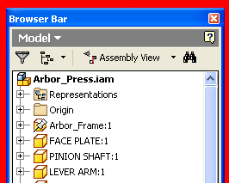
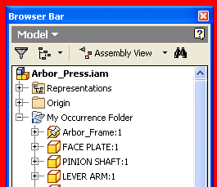
Browser Folders
Ability to create a browser folder within the assembly or sketched symbol area of the browser
Provides a way to organize occurrences and symbols within the of browser
BrowserFolder
BrowserPane.AddBrowserFolder
Notes:
Browse folders are a new feature that allow user-defined grouping of items in the tree view. These screenshots on this slide show before and after images of a browser folder. On the left you see the usual assembly view. On the right you see the user has created a custom folder and how did the logical set of parts to that folder. This makes the assembly tree much easier to read. Browse the folders are only supported in assemblies. They wouldn’t make much sense in a part, as the ordering of features determines the end result.
Public Sub AddAssemblyBrowserFolder()
Dim odoc As AssemblyDocument
Set odoc = ThisApplication.ActiveDocument
Dim oDef As AssemblyComponentDefinition
Set oDef = odoc.ComponentDefinition
Dim oPane As BrowserPane
Set oPane = odoc.BrowserPanes.ActivePane
' Create an object collection that will be used to pass in the set of nodes to group.
Dim oOccurrenceNodes As ObjectCollection
Set oOccurrenceNodes = ThisApplication.TransientObjects.CreateObjectCollection
Dim oOcc As ComponentOccurrence
For Each oOcc In oDef.occurrences
' Get the node associated with this occurrence.
Dim oNode As BrowserNode
Set oNode = oPane.GetBrowserNodeFromObject(oOcc)
' Add the node to the collection.
oOccurrenceNodes.Add oNode
Next
' Add the folder to the browser and specify the nodes to be grouped within it.
Dim oFolder As BrowserFolder
Set oFolder = oPane.AddBrowserFolder("My Occurrences Folder", oOccurrenceNodes)
End Sub

Slide 16
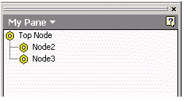
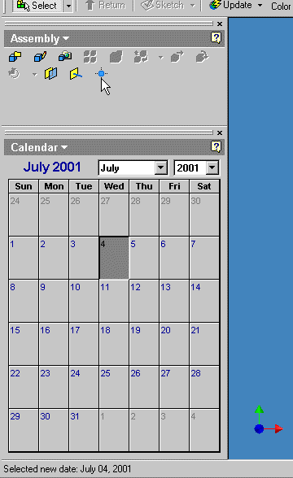
Lab:
In a part document, add a browser pane
like the figure, that lists all the features
in the part. Highlight the corresponding
feature when mouse is hovering on a
node.
In a document, add a browser pane that
hosts a .Net UserControl.
In an assembly, create a browser folder
to place all the occurrences whose
names have the prefix “part1”.

Slide 17

Notes:
Thank you!
Questions?

